Slide 1


LED Input Detection for
Gadget Board
Luciano Regis Orlandini - 460952
Applied Computer Science
Notes:
Hello and Welcome
I’m Luciano Orlandini
Presentation title

Slide 2


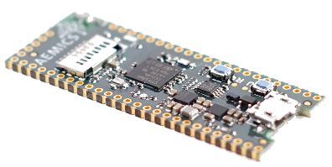
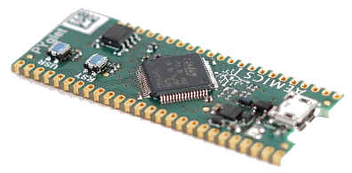
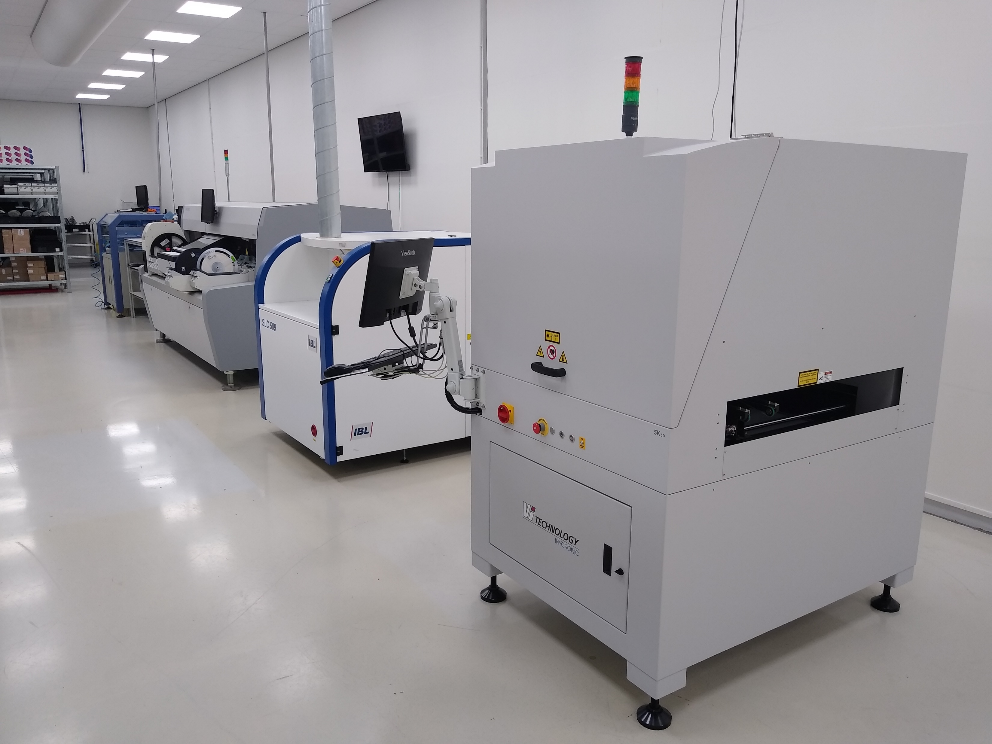
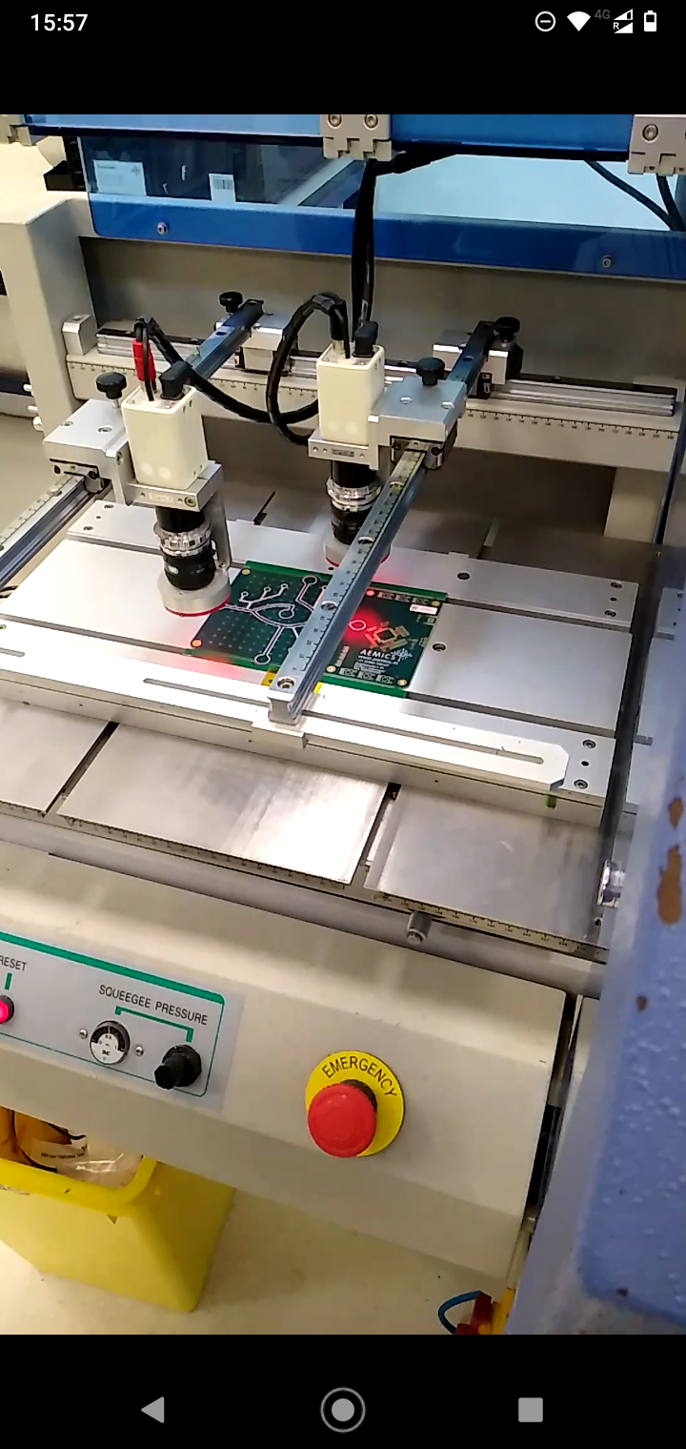
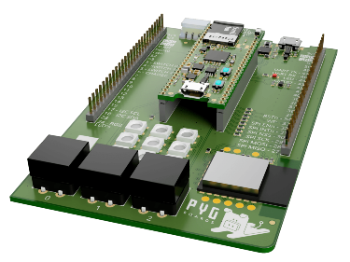
Company
Aemics
Oldenzaal
25 employees
Proof-Of-Concepts
On-site production
Own products
Notes:
Clients approach with an idea or problem
Proof-of-concept becomes prototype

Slide 3
Index
Introduction
Original System Analysis
Research
System Requirements
Proof-Of-Concept
Mobile Port
Conclusion
Recommendations
Discussion

Slide 4
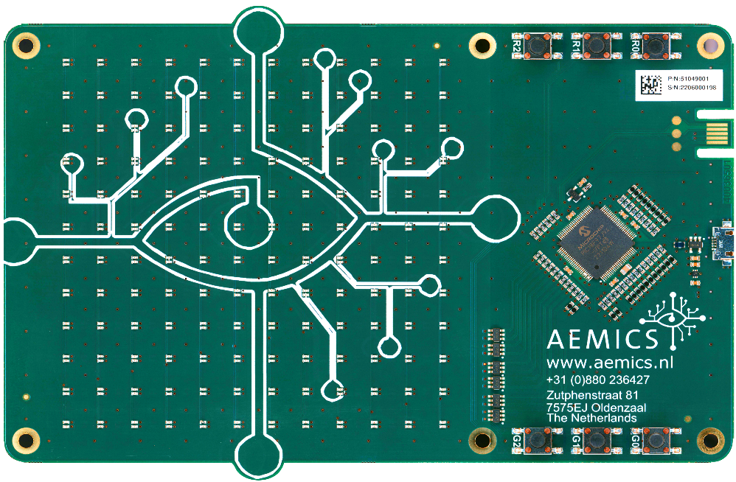
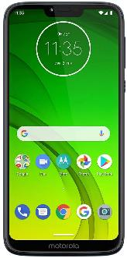

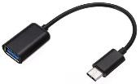

1. Introduction
Project Background
Gadget Board
PIC18FXXJ97
12 x 12 LED Matrix
6 Push-buttons
Embedded Software
Mobile Phone
Touch Screen
OTG cable
Flutter app
Notes:
In a previous graduation assignment, an electronic gadget board was developed
MCU controls status of LEDs – on and off
Matrix used as a display, similar to a square 144-pixel screen
Embedded software communicates via serial USB to…
Mobile phone – with a touch screen
On the go cable for connection
Flutter app with tic tac toe logic, telling MCU what to display and when
Input only possible via push buttons and touch screen

Slide 5
1. Introduction
Objective
Study
LEDs detect light
Hardware prepared for this
Goal
POC that uses LEDs as input
Increase board functionality
Port to mobile
Develop extra games
Notes:
Previous study was made at the company showing that LEDs detect light
Hardware is connected in a way to enable reading the output of the detection
Make POC in a computer that uses LEDs to recognise touch, acting as an input source similar to the touch screen
Port to mobile
Make more games to show functionality
Gadget to be used as a giveaway in open days

Slide 6
Index
Introduction
Original System Analysis
Research
System Requirements
Proof-Of-Concept
Mobile Port
Conclusion
Recommendations
Discussion
Notes:
Now I’ll detail some key features of the gadget board for context, discovered during a system analysis phase

Slide 7
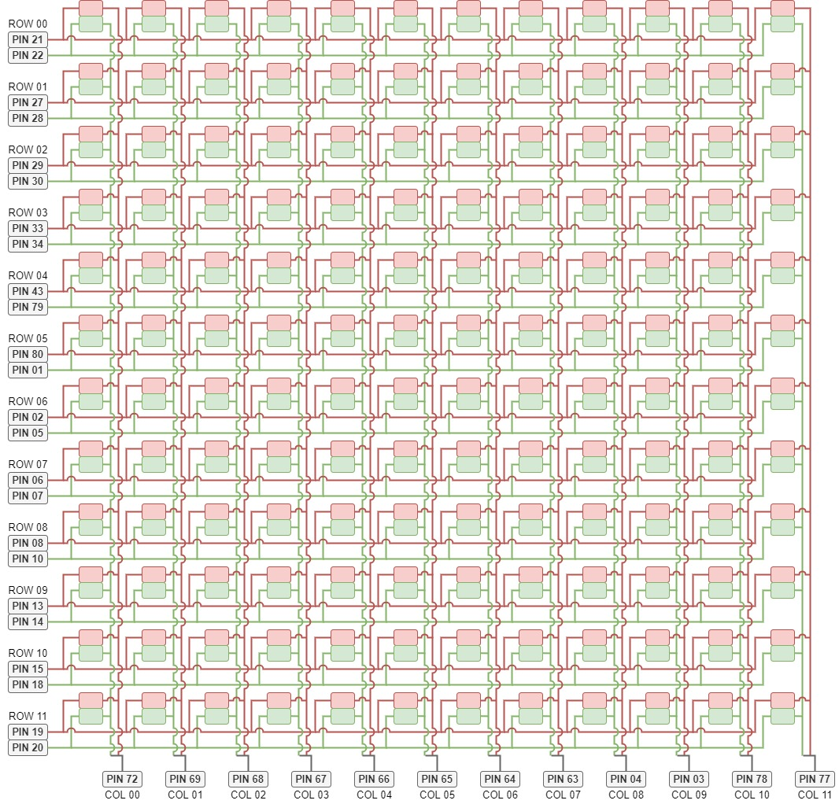
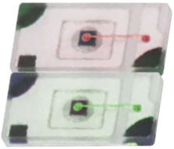
2. Original System Analysis
LED Matrix
144 pairs – 1 red and 1 green
12 rows of 12 red LEDs
12 rows of 12 green LEDs
24 I/O pins
12 I/O pins – one per column
Notes:
The 12 x 12 matrix is actually made up of 144 pairs or LEDs – one red, one green
There are 12 rows for each colour, needing 24 I/O pins
12 extra pins are used to connect each column together. These pins are ADC capable

Slide 8
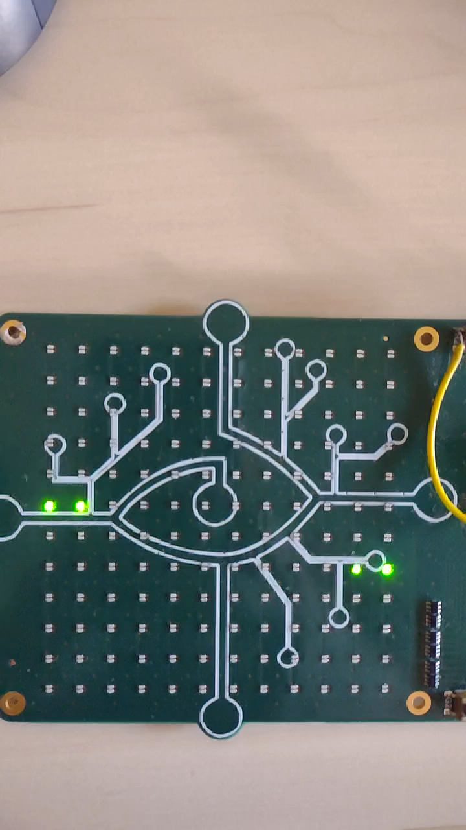
2. Original System Analysis
Output
ADC polling
12 x 12 Array of ADC readings
3.47 Hz
1 x 6 array for push-buttons
LM=[[550 555 551 563 562 560 552 558 559 556 557 564]
[558 561 559 564 551 556 555 550 560 562 554 553]
. . .
[552 564 562 557 560 558 559 556 550 561 554 551]
[551 559 560 554 557 564 555 552 562 558 550 553]]
(12, 12), dtype=”String”
BM=[[0 0 0 1 0 0]]
(1, 6), dtype=”String”
Notes:
The system regularly samples the light being detected by LEDs – one at a time – and does an ADC
The values are saved in a 12 x 12 array and then transmitted via serial with header LM
Frequency in which a full LED is transmitted is 3.47Hz
An array of size six as seen gets sent via serial with header BM to tell the mobile logic when one of the push buttons is pressed.

Slide 9
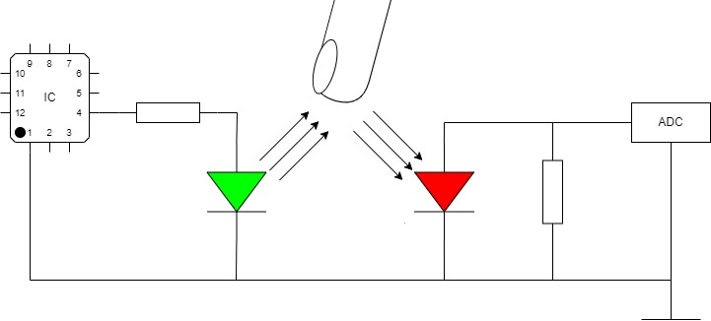
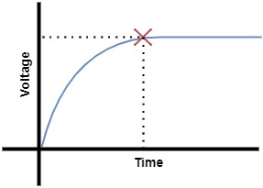
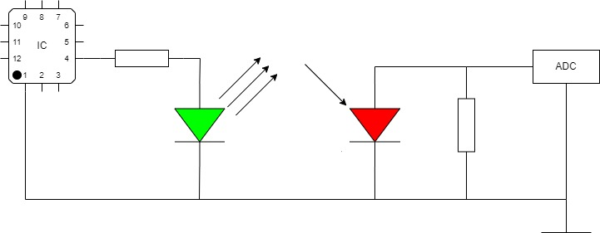
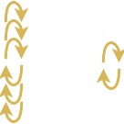
2. Original System Analysis
Initial Tests
LED light detection
Notes:
Initial tests realised to understand how to influence the ADC values.
Touching a LED increases the value for that index of the 12 x 12 matrix, while a shadow reduces it.

Slide 10
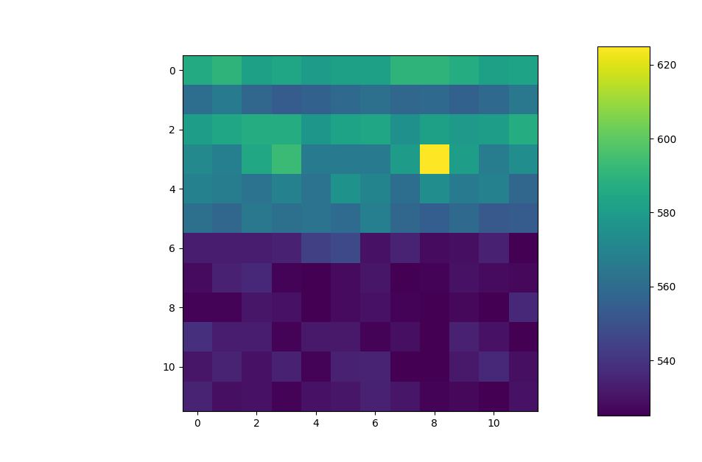
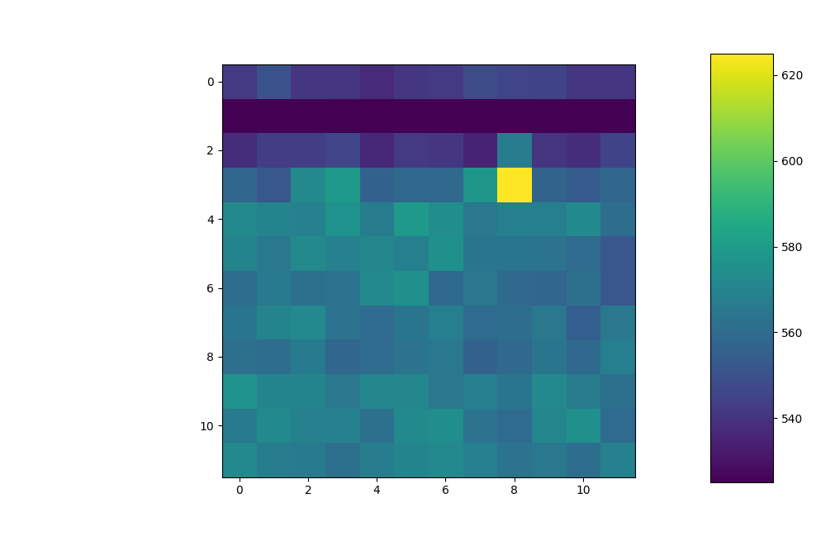
2. Original System Analysis
Initial Tests
Same touch, different readings
Notes:
Direction of approach of the matrix caused a completely different reading despite touching same location, so any algorithm would need to account for that.
A simple python script was made to try and detect touch using the ADC value of a single LED but results were insufficient.
More details can be said at the end, but at that point I knew I needed an algorithm that would interpret the matrix as a whole in order to accurately detect touch.

Slide 11
Index
Introduction
Original System Analysis
Research
System Requirements
Proof-Of-Concept
Mobile Port
Conclusion
Recommendations
Discussion
Notes:
Having performed a full analysis of the given system, I started a research phase to understand all technologies involved and the ones I would need to implement in the POC

Slide 12
3. Research
Main Question
Is it feasible to use the output of the light detection capability of the LEDs within the Gadget Board, to detect when and where the LED matrix is being touched?
Notes:
To provide direction to research, I defined a main question that the POC would need to answer, which is:
I then broke down the question into sub questions to help with development.
Sub-questions
How do LEDs detect light and how can this be measured and any output values interpreted?
What is an Analogue-to-Digital Conversion and how can any output values be interpreted?
What types of algorithms are suitable for fast predictions based on input data?
How can such algorithms be deployed?
Machine learning classifiers stood out, using labelled data.
More details can be discussed after the presentation

Slide 13
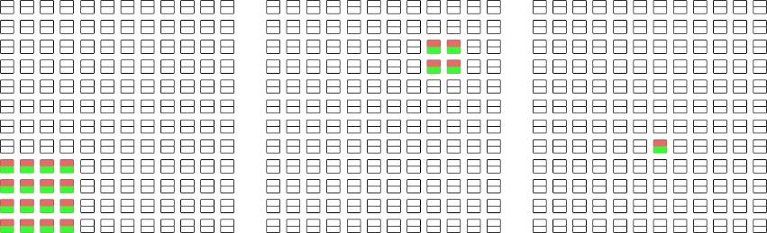
4. System Requirements
MoSCoW
Accuracy
3 levels
Data Gathering
CSV
Hardware requirements
Desktop computer
Existing LED matrix
Software requirements
Game playable
Port to mobile
Semi-Accurate
Accurate
Very Accurate
540,538,535,542,534,541,525,532,530 … 540,542,535,539,534,533,531,531,530,7
Notes:
Looking at the objective, results of the analysis and research, the POC requirements were defined using MoSCow
The definition-of-success of the project was agreed between my supervisor and me, and covered the following areas
I talked about detecting touch accurately, but what is accurate? 3 definitions were made.
9, 36 and 144 different outputs. At least semi-accurate detection was needed.
Data gathering had to be somewhat automated. At this point CSV was chosen as format
Hardware
Desktop computer, led matrix of gadget board
Software to be ported to mobile phone as an extra

Slide 14
Index
Introduction
Original System Analysis
Research
System Requirements
Proof-Of-Concept
Mobile Port
Conclusion
Recommendations
Discussion
Notes:
Once requirements were defined, work on the POC began

Slide 15
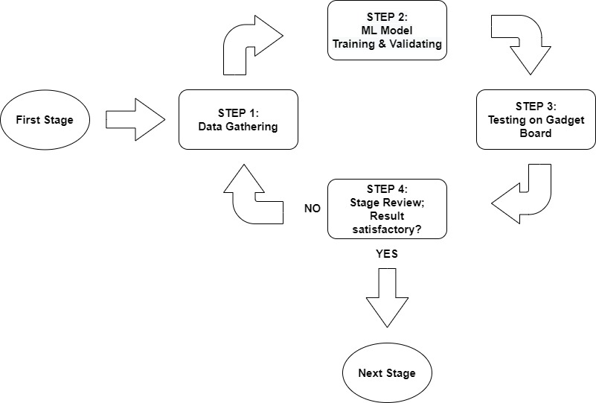
5. Proof-Of-Concept
Development Framework
Step – Stage – Iteration
Notes:
I first created a development framework, which would ensure the POC got thoroughly tested
I called it a step, stage, iteration approach as per the image
POC was developed in steps: Data gathering, training and validating a ML model, testing on the gadget board, and reviewing results.
Each accuracy level had all these steps. I referred to the process for each one as a stage.
When all 3 stages were complete, I referred to it as an iteration.
This photo represents this better

Slide 16
5. Proof-Of-Concept
Test Suite
Four tests
Certify specific requirements
Aid in planning the program
TEST ID | TEST NAME | SYSTEM REQUIREMENT
T-01 | Game Round Generation | --
T-02 | Labelled Data Gathering | M-03
T-03 | Model Accuracy | M-01 / S-01
T-04 | Model Speed | M-02 / S-02
Notes:
The test suite comprise unit tests that would certify specific system requirements.
These were defined before development to help ensure all functionality required to the POC would be included so it passed the user acceptance test at the end.

Slide 17
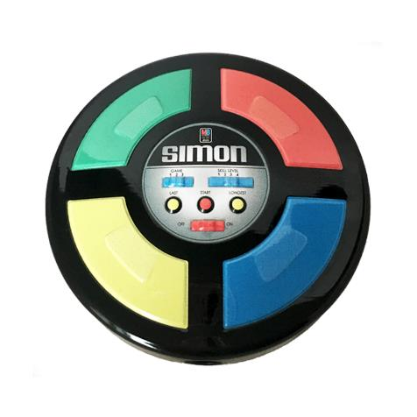

5. Proof-Of-Concept
Design
Step I: Data Gathering
Step II: Model Training & Validating
Step III: Testing on Gadget Board
Step IV: Stage Review
& III
Step I
Step II
Notes:
The actual application was then developed in steps as previously mentioned, with each forming a part of the POC
Step I was a game, Simon Says was the inspiration. The game was used to gather data, by telling the user to touch the LED matrix in specific parts and then saving those ADC readings with a label attached. The label was the position where the game logic told the user to touch.
Step II was a Jupyter notebook to pre-process data, train the model and evaluate its performance and then export it.
Step III was an adaptation of the game of step 1, but instead of saving the ADC values from the gadget board it would pass them to the model created. This result would be used to progress the game logic
Step IV was reviewing results and analysing the playability of the game in the gadget board

Slide 18
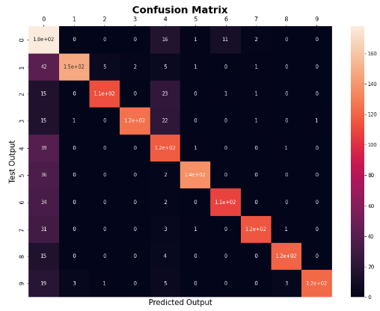
5. Proof-Of-Concept
Naïve Bayes
Results
STAGE | CERTIFIED REQUIREMENTS | TEST DATA ACCURACY (%) | REAL LIFE ACCURACY (%) | GAME PLAYABLE DURING STEP III?
1 | T-01 / T-02 / T-03 / T-04 | 77 | ~80 | No
2 | T-01 / T-02 / T-03 / T-04 | 3 | -- | No
3 | T-01 / T-02 / T-03 / T-04 | -- | -- | --
1st Iteration
Naïve Bayes
Confusion Matrix
Notes:
Accuracy seen is the best, it started at around 20% and increased with adjustments and more data gathering
Varied hand placement for stage 1. Stage 2 not so much
Confusion matrix shows a lot of mistakes
Model not good for several outputs

Slide 19
5. Proof-Of-Concept
Results
Logistic Regression
STAGE | CERTIFIED REQUIREMENTS | TEST DATA ACCURACY (%) | REAL LIFE ACCURACY (%) | GAME PLAYABLE DURING STEP III?
1 | T-01 / T-02 / T-03 / T-04 | 93 | ~95 | Yes
2 | T-01 / T-02 / T-03 / T-04 | 99 | ~70 | Partially
3 | T-01 / T-02 / T-03 / T-04 | 98 | ~15 | No
2nd Iteration
Logistic regression
Extra pre-processing
for i in range (0, 144):
indexes = data[(data[str(i)] < 450) | (data[(str(i))] > 650)].index
data.drop(indexes, inplace=True)
data.reset_index(drop=True, inplace=True)
Notes:
Despite high accuracy, game was still unplayable in real life.
Only a couple of rounds would go through in stage 2
Percentage was lower at the beginning
Pre-processing to remove outliers
Min max scaler applied
Same had to be applied to Step III
Model not good with new data

Slide 20
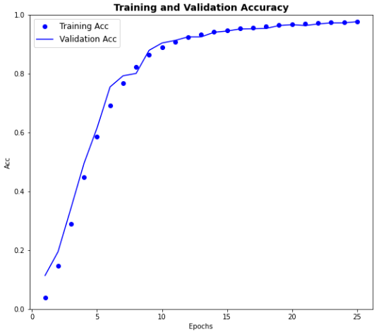
5. Proof-Of-Concept
Results
Neural Network
STAGE | CERTIFIED REQUIREMENTS | TEST DATA ACCURACY (%) | REAL LIFE ACCURACY (%) | GAME PLAYABLE DURING STEP III?
1 | T-01 / T-02 / T-03 / T-04 | 94 | ~95 | Yes
2 | T-01 / T-02 / T-03 / T-04 | 99 | ~95 | Yes
3 | T-01 / T-02 / T-03 / T-04 | 97 | ~70 | Partially
3rd Iteration
Sequential neural network
Epochs
Convert to .tflite
TensorFlow
neural_net.save('nn_led')
converter = tf.lite.TFLiteConverter.from_saved_model('nn_led')
tflite_model = converter.convert()
with open('nn_led.tflite', 'wb') as f:
f.write(tflite_model)
Notes:
Complex model but results are in line with real life, except for stage 3, where real accuracy is good on some LEDs but not others
Epochs show model learning
Looking at porting possibilities, needed tflite.
Converted whole model to TensorFlow, which is a wrapper around sklearn

Slide 21
Index
Introduction
Original System Analysis
Research
System Requirements
Proof-Of-Concept
Mobile Port
Conclusion
Recommendations
Discussion
Notes:
These results showed me how having the step – stage – iterations framework allowed me to test a complete application for all different models, learning along the way

Slide 22

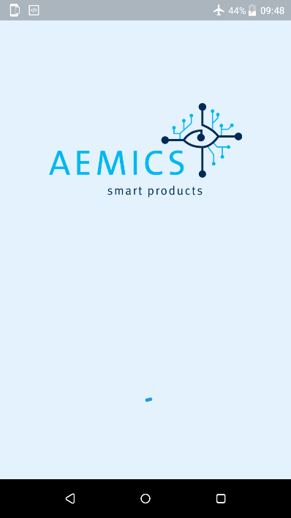
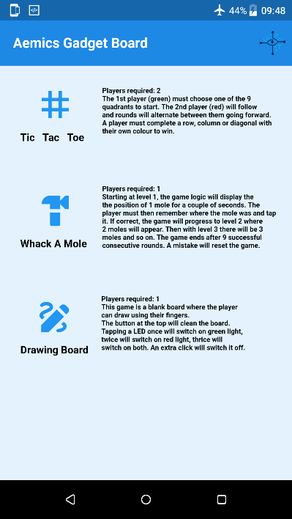
6. Mobile Port
App
Icon
Splash Screen
Start Page
.tflite model
.tflite_flutter
Notes:
Complete redesign of mobile application

Slide 23
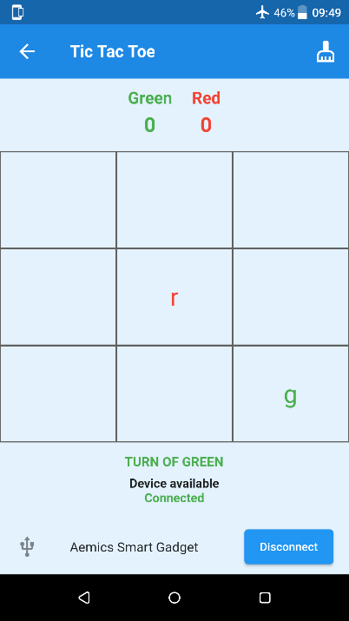
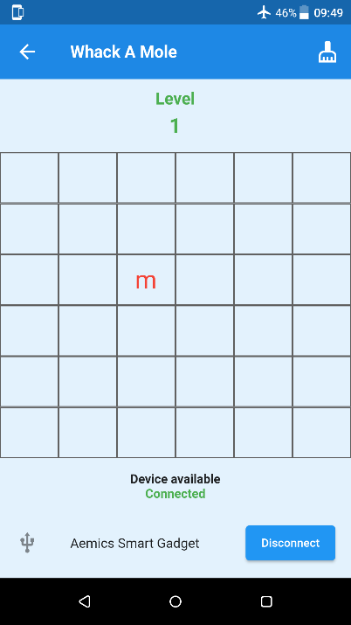
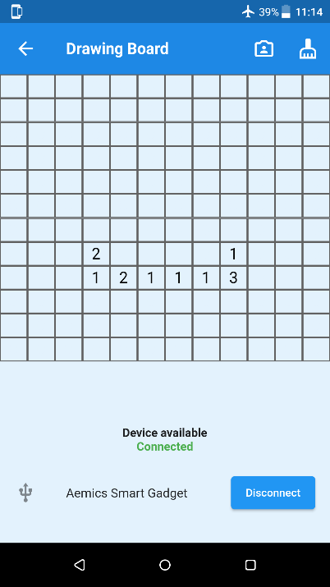
6. Mobile Port
Games
Tic Tac Toe
Whack-a-Mole
Drawing Board
Notes:
Each game has a unique screen and uses one of the 3 accuracy levels

Slide 24
Index
Introduction
Original System Analysis
Research
System Requirements
Proof-Of-Concept
Mobile Port
Conclusion
Recommendations
Discussion

Slide 25
7. Conclusion
MUST requirements certified
Most SHOULD requirements certified
One COULD requirement certified
Is it feasible to use the output of the light detection capability of the LEDs within the Gadget Board, to detect when and where the LED matrix is being touched?
Notes:
So , read question

Slide 26
8. Recommendations
Recommendations
Software
Data
Mobile App
Cloud Support
Hardware
Extra output
More boards are required
LED spacing
Independence
Notes:
Continue gathering data for board, richer and more varied
Refine mobile app as the board may be used as a giveaway in open days
Cloud support to save more data and retrain model
More boards are required
Extra output via buzzer and OLED screen
Try increasing LED spacing
Change MCU to 32-bit compatible with tflite and become independent from mobile phone

Slide 27
9. Discussion
Thank you!

